Slide 1
GENERAL ASSEMBLY
DATA SCIENCE

Slide 2
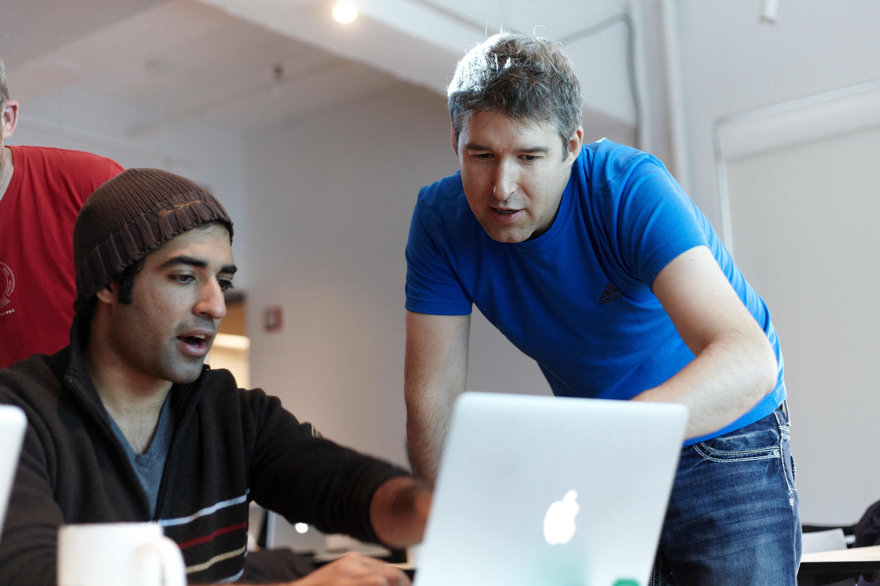

MEET YOUR INSTRUCTORS

Slide 3
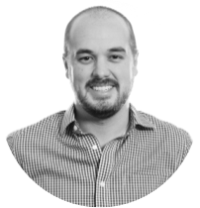

Daniel Demoray
ddemoray@ga.co
Education Programs Producer
ABOUT YOUR PRODUCER!
STUDENT
INSTRUCTOR
CURRICULUM

Slide 4
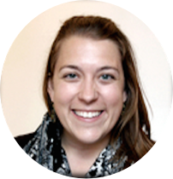
ABOUT YOUR INSTRUCTOR!
Dr. Amy Roberts
uncamy@gmail.com
Data Science Instructor
STUDENT
INSTRUCTOR
CURRICULUM

Slide 5
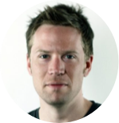
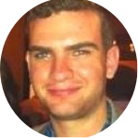
ABOUT YOUR EXPERTS IN RESIDENCE!
Corey Maher
corey.maher@gmail.com
Oscar Insurance
Tom Hunter
tom.s.hunter@gmail.com
Heat Seek NYC
Ellington Management Group

Slide 6
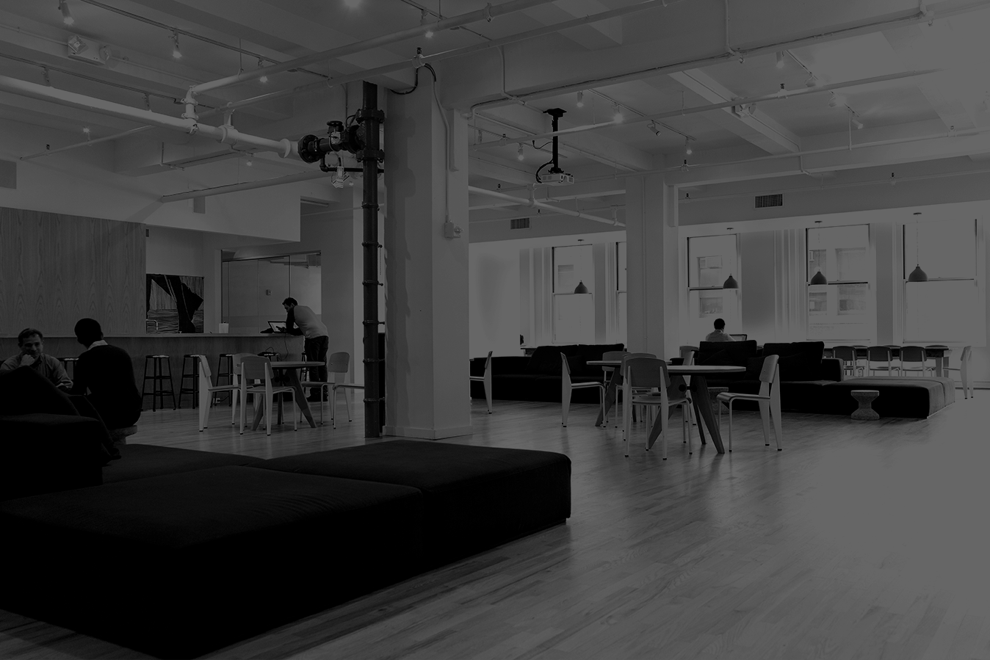

ABOUT
GENERAL ASSEMBLY

Slide 7
GENERAL ASSEMBLY IS A global community of individuals empowered to pursue the work we love.

Slide 8
General assembly’s mission is to build our community by transforming millions of thinkers into creators.

Slide 9

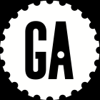
TOOLS

Slide 10
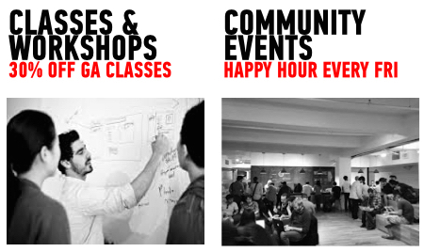
Notes:
Your course producer will email you with the discount code.
Happy Hour takes place on the 3rd floor at 10 East 21st St from 5:30 - 8:00 PM.

Slide 11

The best events in tech, business, and design — handpicked each week by our community curators.
Join at hub.ga.co/ny
Take a sneak peek of the mobile app at bit.ly/hubiosbeta
Notes:
- Great way to network outside of GA campus at events around the city that are affordable. Everyone should download this before the end of class tonight to start checking out events around the city / invite classmates to go with them!

Slide 12

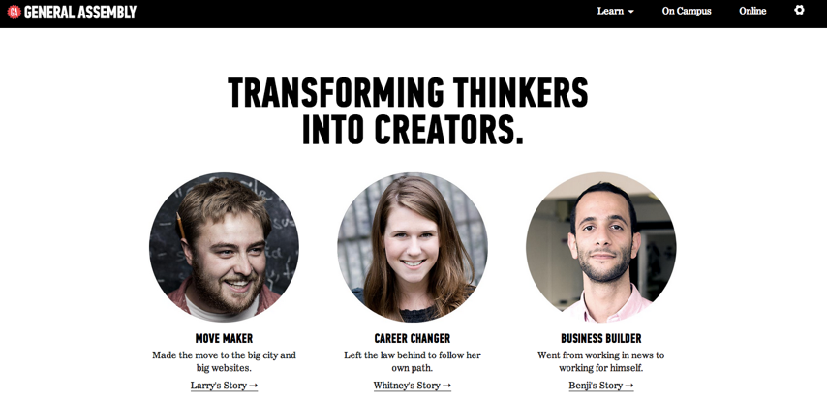
FEEDBACK / SUPPORT
Access to EIRs: office hours, in class support
Exit Tickets
Mid-Course Feedback
End of Course Feedback
Notes:
Feedback is a part of the GA experience. It is used to tweak the DAT experience from instance to instance. Helps instructors know what’s working well and what can be improved. Your producer, Daniel also communicates feedback to the appropriate teams that work behind the scenes at GA.

Slide 13
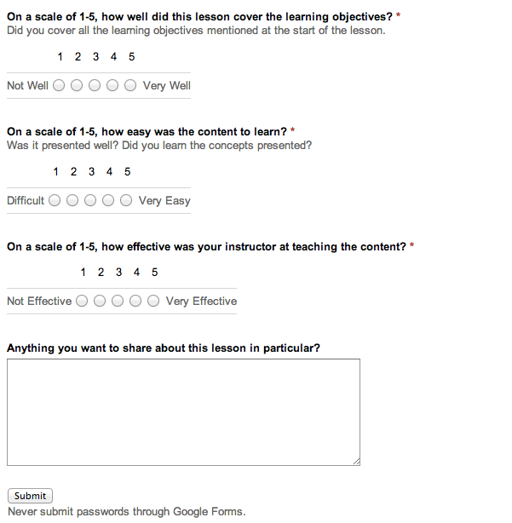
Exit Tickets
Notes:
- Feedback at the end of each class is required if you want to make the most of your GA experience. This lets how know how to

Slide 14
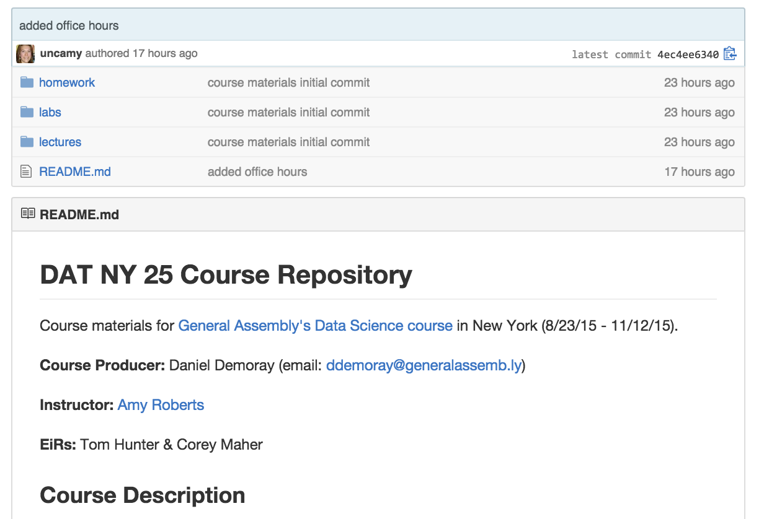
Course Site
https://github.com/ga-students/DAT-NYC-25
Notes:
Feedback is a part of the GA experience. It is used to tweak the DAT experience from instance to instance. Helps instructors know what’s working well and what can be improved. Your producer, Daniel also communicates feedback to the appropriate teams that work behind the scenes at GA.

Slide 15

ROAD TO SUCCESS

Slide 16
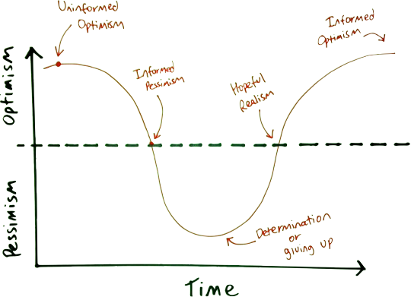
EMOTIONAL CYCLE OF CHANGE
Notes:
- We understand that everyone is working full time outside of class and that sometimes things happen. Let us know! Please email us if you have to miss class ahead of time.
Taking a class while working is a big commitment. Let us know if something is going on outside of class / need extra help! We’re here to help you make the most out of this class. Your course producer, Dan - is happy to chat if you have any questions about GA / policies if I don’t know the answer.

Slide 17
Student Responsibility
As a self directed program, we view students as a crucial part of the skill acquisition process.
GA |  | YOU
50% |  | 50%
Notes:
- General Assembly is like a gym - you have to put in the work to get results.

Slide 18
GA Graduation Requirements
HOMEWORK
(COMPLETE 80% OF
HOMEWORK/LABS)
ATTENDANCE
(MISS NO MORE THAN 2 CLASSES)
COMMUNITY
ENGAGEMENT
FINAL PROJECT
PARTICIPATION + FEEDBACK

Slide 19
Forever and ever
BUILD YOUR
NETWORK
FIND
OPPORTUNITIES
13,000+
STRONG
PERKS!
15% OFF CLAASSES AND WORKSHOPS, $500 TUITION CREDIT
It’s not just about altruism, your network is your most valuable asset
Alumni have started companies together and recruited other alumni to join their teams
You’re part of the alumni community forever
We can’t wait to have you back on campus
Notes:
Network in class and out of class.
Meet people while grabbing coffee in the kitchen, at the weekly happy hour and at industry events through HUB.
Once you graduate you unlock Alumni perks to continue learning!
15% off Classes and Workshop
$500 Tuition Credit
Alumni Newsletter

Slide 20

ASK AWAY!

Slide 21
INTRODUCTIONS
3 min- Partner with someone next to you. Introduce yourselves! When we reconvene, you will introduce your partner to the group
Name
Current favorite tool for working with data
What can you help your classmates with when it comes to data analysis?
What you most excited about learning more about?
Favorite NY end of summer activity (blatantly searching for things to do before it gets cold)
Notes:
Feedback is a part of the GA experience. It is used to tweak the DAT experience from instance to instance. Helps instructors know what’s working well and what can be improved. Your producer, Daniel also communicates feedback to the appropriate teams that work behind the scenes at GA.

